Slide 1
Core Java And Database(Oracle)

Slide 2
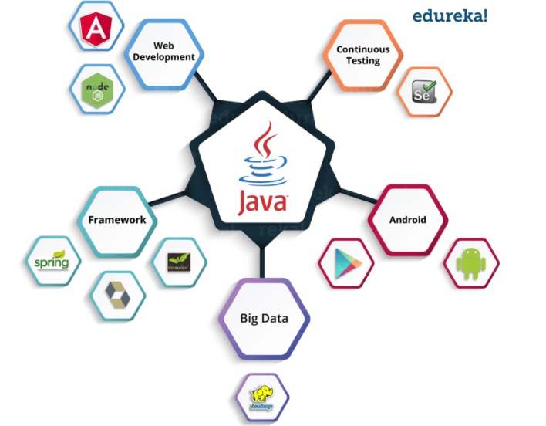
Why Java?
Portability across platforms and Operating Systems…
Fast Reliable and secure.
Java is an Object Oriented Programming Language
Modular
Flexible
Extensible
Java platform consists of
Java Runtime Environment (JRE) which is needed to run Java applications and
Applets
Java Development Kit (JDK).

Slide 3




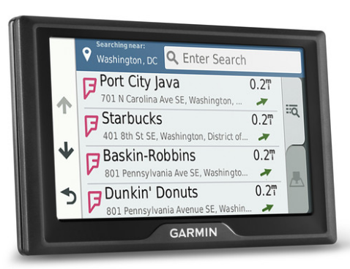
Statistics/Result
6.5 million developers
1.1 billion desktops run java
930 million JRE downloads every year!
3 billion mobile phones run java
Application Areas
Internet
Games
Datacenters
Car Navigation Systems
Lottery Terminals

Slide 4
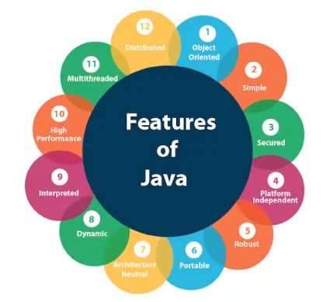

Slide 5
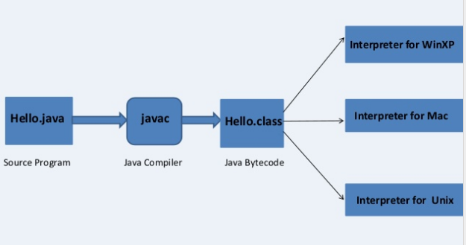

Slide 6
